Slide 1
TOPIC:
Modes of Transfer
(Lecture 32)
By - Sagar Juneja (Asst. Dean, CURIN)

Slide 2
Three predominant modes of transfer
Different modes of data transfer between computer (memory) and I/O devices -
Programmed I/O
Interrupt-Initiated
Direct Memory Access (DMA)
CPU controls the transfer
CPU executes several instructions
Continuous monitoring of flag bit
Slow and inefficient
CPU is involved in the transfer
No continuous monitoring of flag bit
Interface interrupts the CPU
CPU is not involved in the transfer of data between memory and I/O
DMA controller takes control of the memory bus
Ideal for fast memories

Slide 3
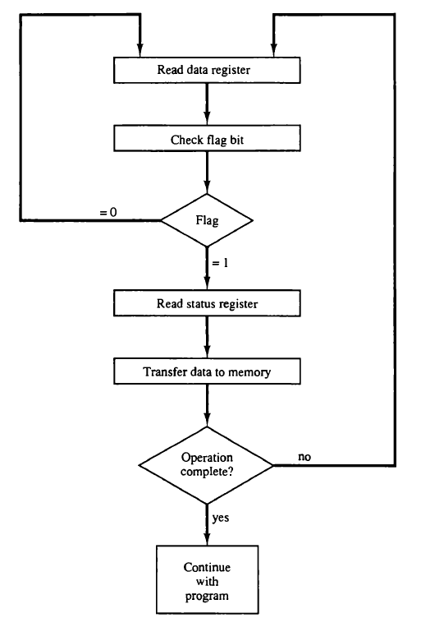
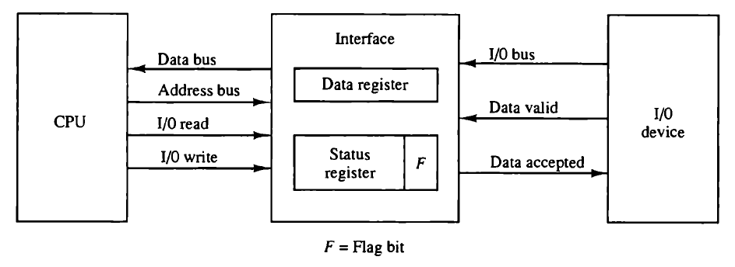
Programmed I/O Example and Flow Chart
I/O devices access memory through CPU using CPU instructions
I/O device puts the data on I/O bus and enables data valid line
The interface accepts data in data register and enables data accepted line
Interface set the flag bit, which allows I/O device to disable the data valid line
CPU program checks the flag bit and controls the data transfer
CPU (or interface) clears the flag after data transfer
This disables the data accepted line
I/O device is now ready to send next byte

Slide 4
Interrupt-Initiated I/O
CPU doesn’t monitor the flag continuously, rather it waits for interface to interrupt the CPU when flag bit is set.
CPU runs a interrupt service routine (ISR) and store the return address on stack.
Two types of interrupts
Non-vectored interrupts : branch address of ISR is at a fixed memory location
Vectored interrupts: source of interrupt provides the branch address of the ISR.
Software Consideration
Computers have software programs (functions) to control the transfer between I/O devices and memory.
These programs issues control commands to activate the I/O devices and also to control other transfer functionalities of the peripherals

Slide 5
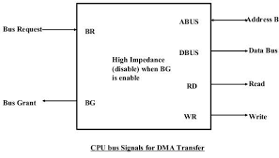
Direct Memory Access (DMA)
Transfer of data between memory and I/O devices without the intervention of CPU
During DMA transfer CPU is idle, and control of the memory bus is with the DMA controller.
DMA controller sends a Bus Request (BR) signal to CPU to relinquish control of buses.
CPU terminates the execution of current instructions and put data bus, address bus and memory read/write lines in high impedance state.
CPU then issues a Bus Grant (BG) access to DMA controller
After the transfer, DMA disables the BR line and CPU disables the BG line
DMA is ideal for high speed memories

Slide 6
Tutorial Question
Why is Programmed I/O mode of data transfer is slow?
Why CPU is in the idle state during the Direct Memory Access?
Direct Memory Access is ideal for slow memories. True or False? Justify your answer.
What is a vectored interrupt?
CPU is actively involved in the transfer of data in interrupt-initiated I/O mode. True or False? Justify your answer.

